Slide 1

Anomaly Detection
Using Federated Learning
Presented By Team 11
Pavan Raj Dasari
Sahithi Thota
Sai Ganesh Pamarti

Slide 2
Presentation Outline
Introduction
Objectives & Challenges
Working Model
Results
Team Contribution
Conclusion
Q&A

Slide 3
Recap
Discussed about federated learning architecture
Discussed anomaly detection techniques
Presented about functioning of algorithms
Approaches on how we were implementing FL

Slide 4
Objectives & Challenges
To simulate anomaly detection using Federated learning.
To eliminate the Malicious data and nodes in the network, mainly focused on sudden spikes and lows
Maintaining energy efficiency - due to processing of FL algorithms they might waste energy if not configured properly.
Lack of standardization - there is no single standard for implementing FL
Lack of labeled data - very less number of datasets present for sensor data with anomalies to label their output

Slide 5
FL Process
We have taken diabetes dataset with 10k records
We split the data into train set (80%) and test set(20%)
We have created 10 clients and distributed training data among the clients
We defined out global model to run for 5 times
Then performed Isolation Forest on each node to remove anomalies at the data level and calculated new weights using SVM model.
Once we have all the weights from the clients, we have performed fed averaging on these weights
Once we have global weight in place we calculated global accuracy and performed next round (repeat from step 5 to 7)
In the final round we have added anomaly node and calculated the accuracy with anomaly node and without anomaly node.

Slide 6
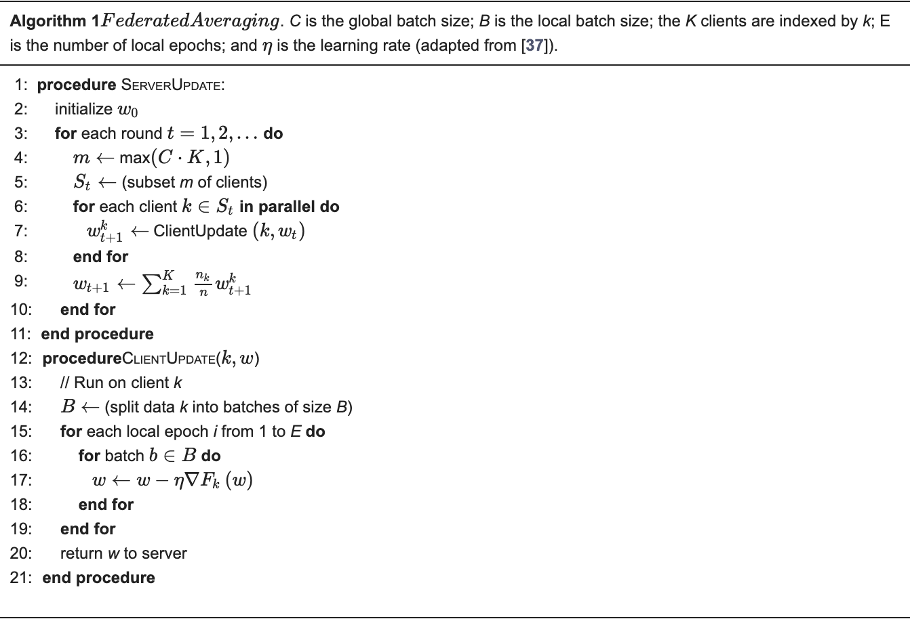
Fed Averaging
Federated Averaging is a distributed machine learning technique that allows for model training using decentralized data from numerous devices or clients without having to share the data.
Reference: https://www.mdpi.com/2076-3417/8/12/2663

Slide 7
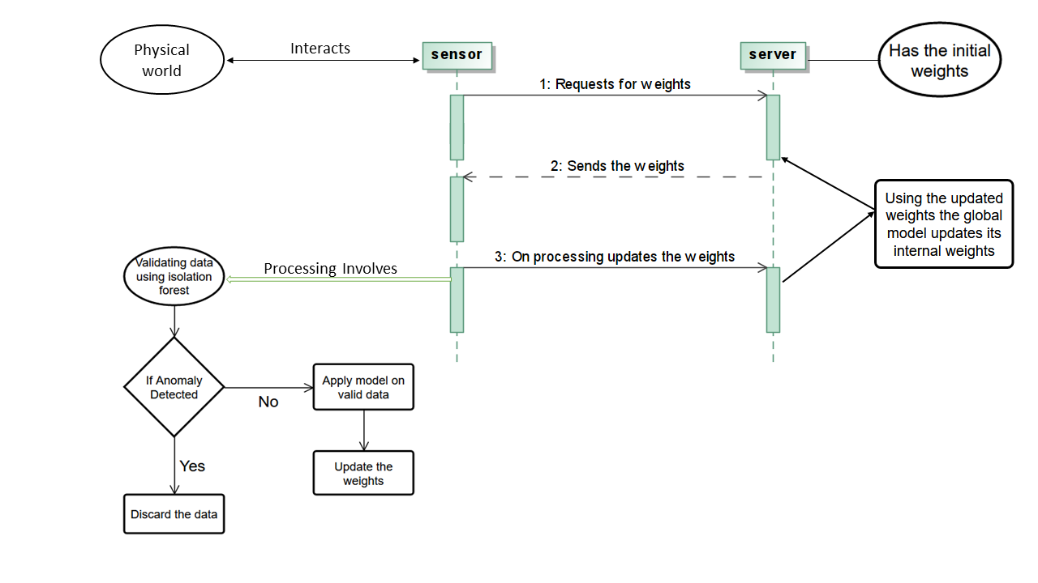
Working Model

Slide 8
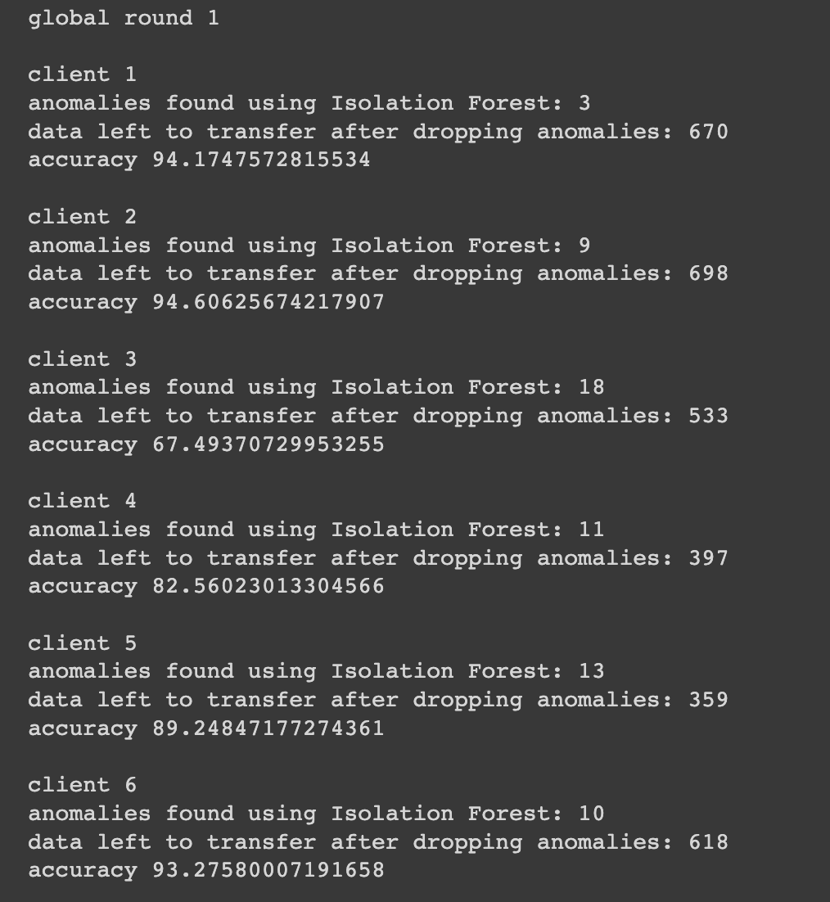
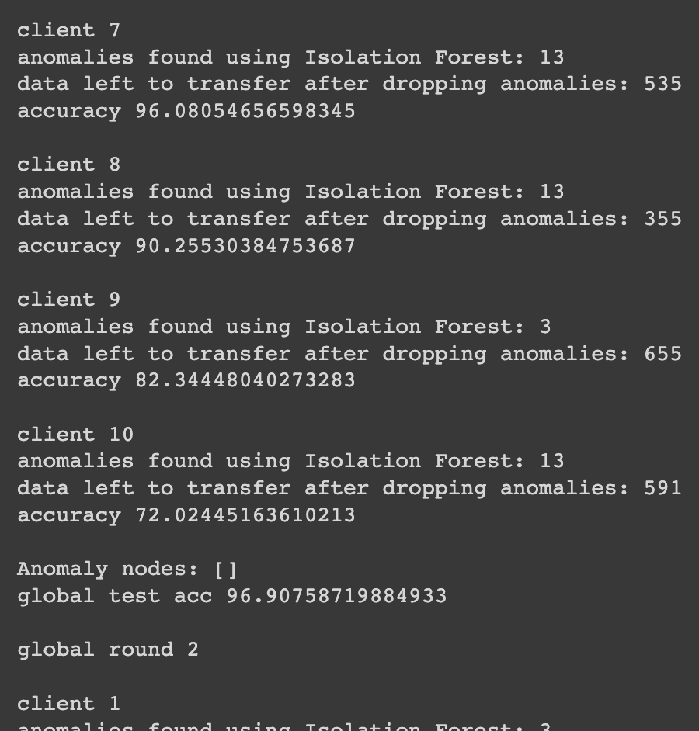
Results
Data level anomaly detection

Slide 9
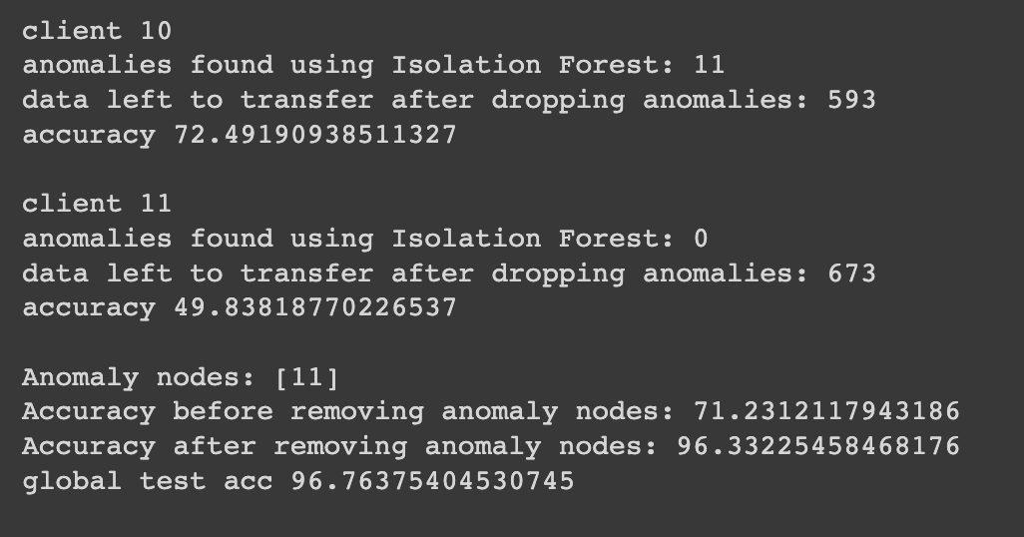
Results
Node level anomaly detection

Slide 10
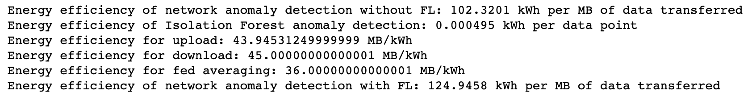
Energy Efficiency
Anomaly detection without federated learning
Data Transfering from sensor to the server
Detecting anomalies
Anomaly detection using federated learning
Model weights transferring from server to sensor
Model weights transferring from sensor to the server
Isolation forest Algorithm
Fed Averaging Algorithm

Slide 11
Problems Faced During Implementation
Faced multiple platform issues while integrating NS3 with ML Packages.
Minimal number of federated learning references, No proper examples due to active research in WSN using FL.
No predefined libraries for fed averaging (has to start from scratch based on the model that we take)

Slide 12
Conclusion
We mainly focused on anomalies present in data level and node level.
The implementation of the federated learning anomaly detection bypasses the drawbacks of existing anomaly detection.
Improves the privacy
No requirement of high computing power
No requirement of gathering whole data into single unit
Based on results, energy efficiency is more for federated learning.

Slide 13

Team Contribution
Content | Pavan Raj | Sahithi | Ganesh
Project Research | 40% | 30% | 30%
Code Implementation | 35% | 35% | 30%
Data Collection | 35% | 35% | 30%
Presentation | 30% | 35% | 35%
Overall | 34% | 33% | 33%

Slide 14
References
A Joint Learning and Communications Framework for Federated Learning over Wireless Networks (arxiv.org/pdf/1909.07972.pdf)
A Federated Learning Approach to Anomaly Detection in Smart Buildings (https://arxiv.org/pdf/2010.10293.pdf)
https://www.mdpi.com/2076-3417/8/12/2663
Federated Learning with Anomaly Client Detection and Decentralized Parameter Aggregation (ieeexplore.ieee.org/document/9833835)

Slide 15

Any Queries??

